Slide 1
Electrical Circuits Lecture 8: RLC Circuits By: Mahmoud Momtazpour ceit.aut.ac.ir/~momtazpour
Amirkabir University of Technology

Slide 2
Topic Overview
RL/RC Circuits: Application
Source-free Parallel RLC Circuits
Source-free Series RLC Circuits
The Complete Response

Slide 3
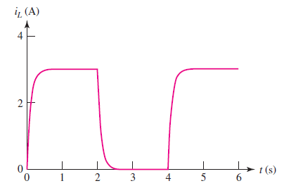
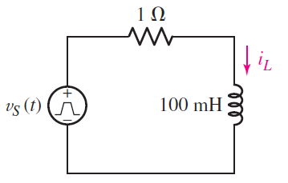
RL and RC Circuits

Slide 4
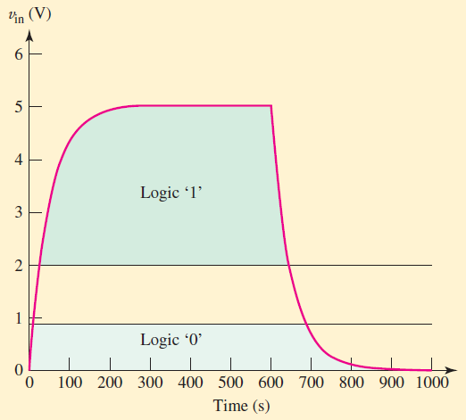
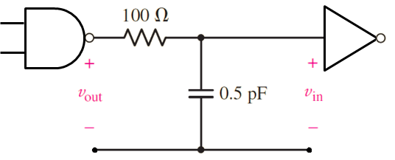
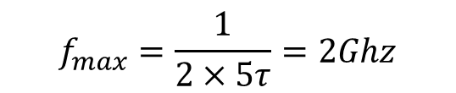
Application in Integrated Circuits
Parasitic R and C on transistors and wires.
Maximum operating frequency:
$$f_{max}=\frac{1}{2×5τ}=2Ghz$$

Slide 5
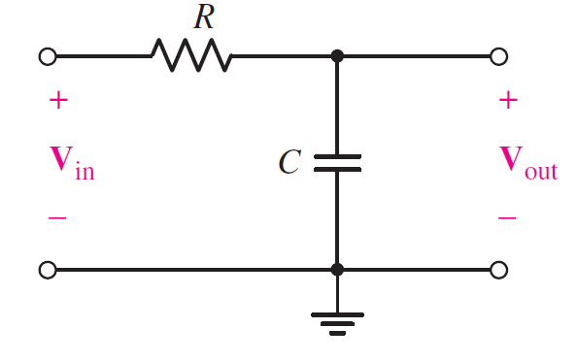
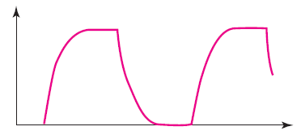
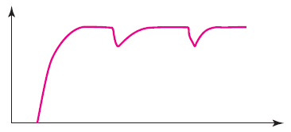
Application as a Filter
A low-pass filter
V_{in}
Low frequency
High frequency
V_{out}
V_{out}

Slide 6
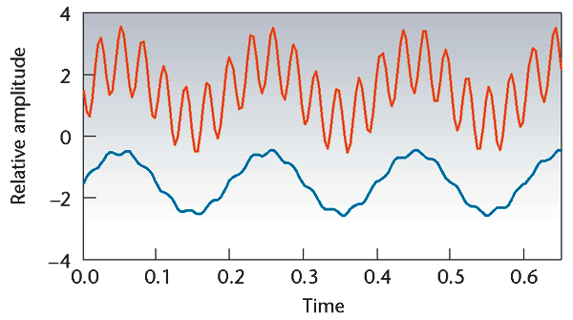
Application as a Filter
A low-pass filter
V_{in}
V_{out}
Notes:
Other applications of Inductors: Relays, Oscillators, Inductive motors, Frequency filters (radio and television to select or filter a frequency), Transformers, Inductive sensors (for traffic detection), etc.
Other applications of Capacitors: Filters, Oscillators, Energy storage, Motor starters, Transistors! etc.

Slide 7
The RLC Circuit
RLC circuit has both
inductor
capacitor
RLC circuits have a wide range of applications, e.g.
oscillators
frequency filters
They also can model automobile suspension systems, temperature controllers, airplane responses, and so forth
Notes:
پاسخ هواپیما به تغییر بالکهای کوچک روی بال، پاسخ آسانسور به فرمان ایست در یک طبقه، رفتار سیستم تعلیق ماشین (شامل فنر و کمک فنر) در هنگام دست انداز، پاسخ یک سیستم کنترل دما در هنگام افزایش یا کاهش دما، همه اینها را می توان به صورت یک مدار RLC مدل کرد.

Slide 8
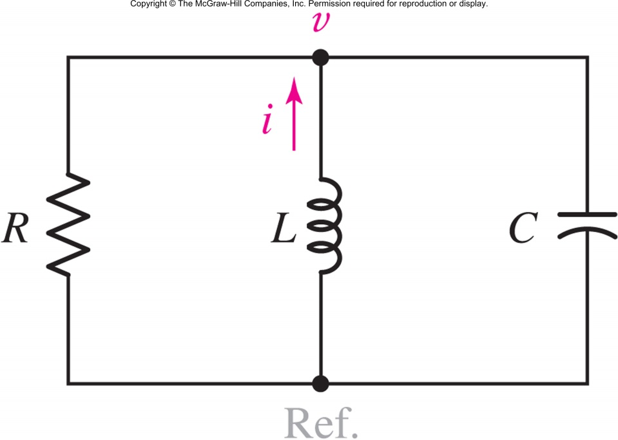
The Source-Free Parallel Circuit
Apply KCL and differentiate to show:

Slide 9
Solving the Differential Equation
To solve, assume v=Ae^{st .}
The solution must then satisfy
which is called the characteristic equation.
If s₁ and s₂ are the solutions, then the natural response is
Answer: i₃(t) = 1.333 sin t V

Slide 10
Exploring the Solution
The solutions to the characteristic equation are
Define ω₀ the resonant frequency:
and α the damping coefficient:
Notes:
W0 فرکانس تشدید و آلفا، ضریب میرایی نام دارد.

Slide 11
Exploring the Solution
With these definitions, the solutions can be expressed as:
The constants A₁ and A₂ are determined by the initial conditions.

Slide 12
Types of Responses
If α>ω₀ the solutions are real, unequal and the response is termed overdamped.
If α=ω₀ the solutions are real and equal and the response is termed critically-damped.
If α<ω₀ the solutions are complex conjugates and the response is termed underdamped.
Notes:
فوق میرا یا میرای شدید (پاسخها حقیقی و نابرابر)
میرای بحرانی (پاسخها حقیقی و برابر)
زیرمیرا یا میرای ضعیف (پاسخها مختلط مزدوج)

Slide 13
Overdamped Response (α>ω₀)
If α>ω_{0,} we have real values for both and
and the solution is

Slide 14
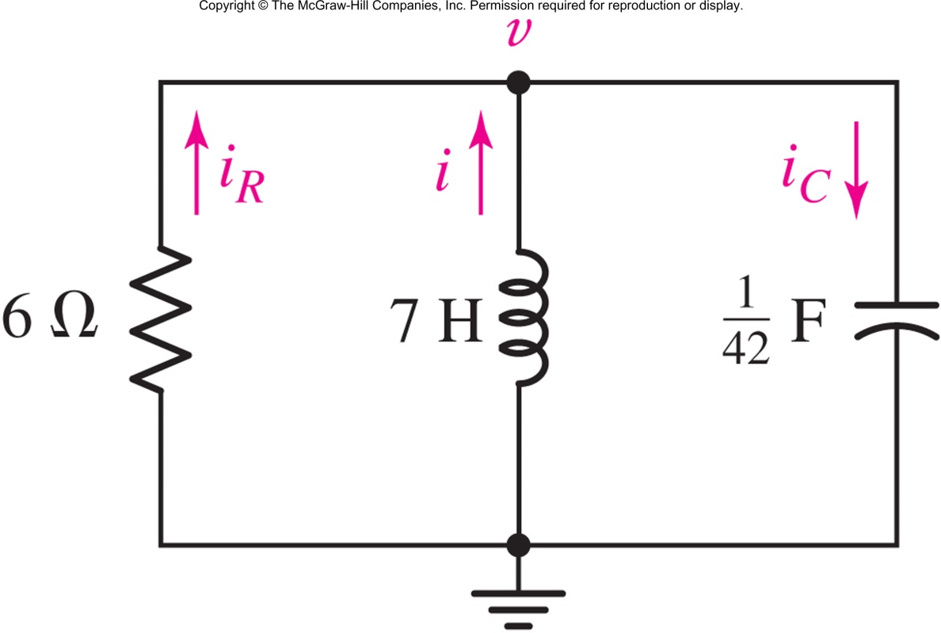
Example: Overdamped RLC Circuit
Show that v(t) = 84(e^{−t} − e^{−6t} ) when i(0⁺)=10 A and v(0⁺)=0 V.

Slide 15
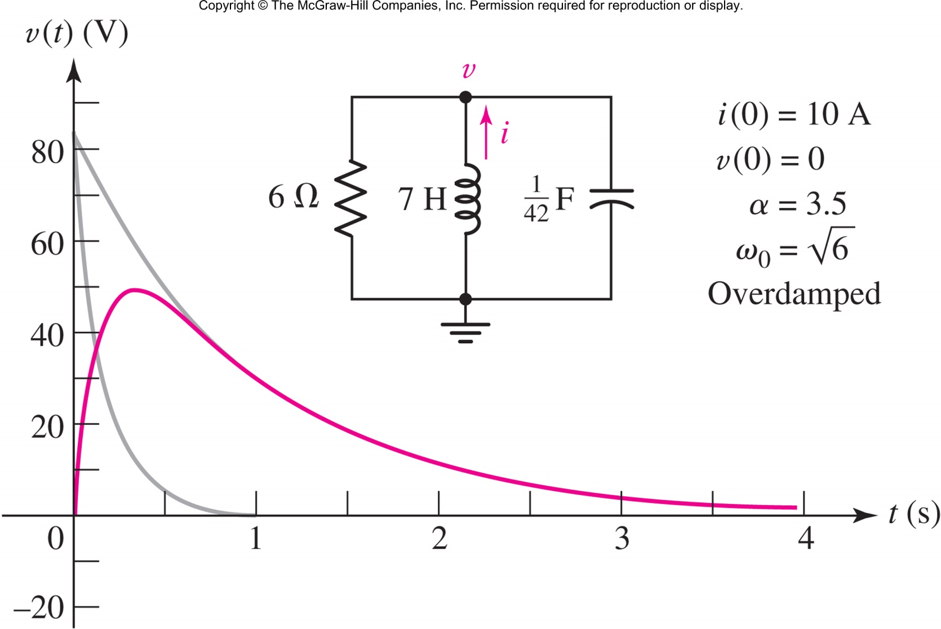
Graphing the Response

Slide 16
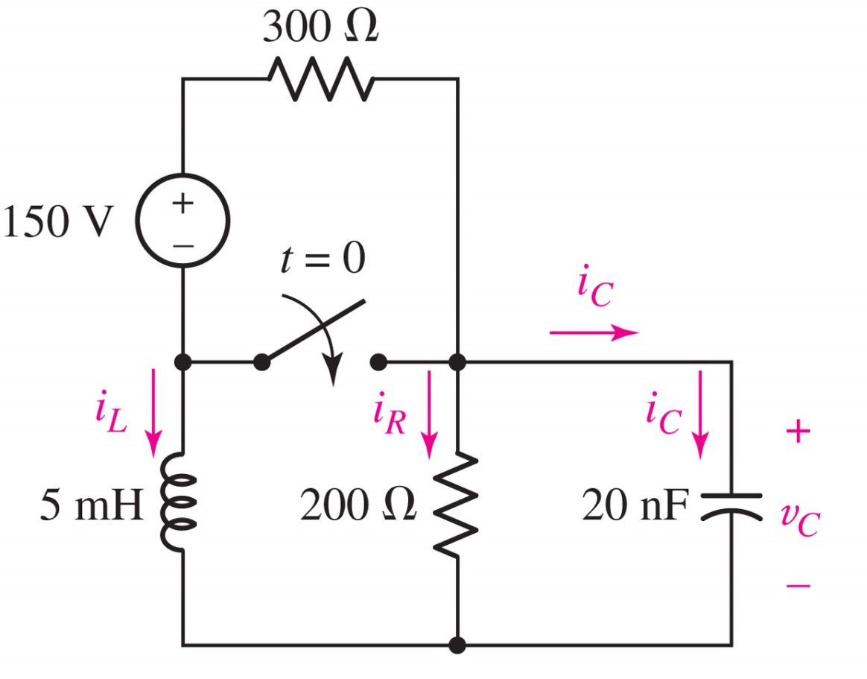
Example: Overdamped RLC Circuit
Show that v_{C}(t) = 80e^{−50,000t} − 20e^{−200,000t} V for t>0.

Slide 17
Critically-damped Response (α=ω₀)
If α=ω_{0,} we have:
and the solution is

Slide 18
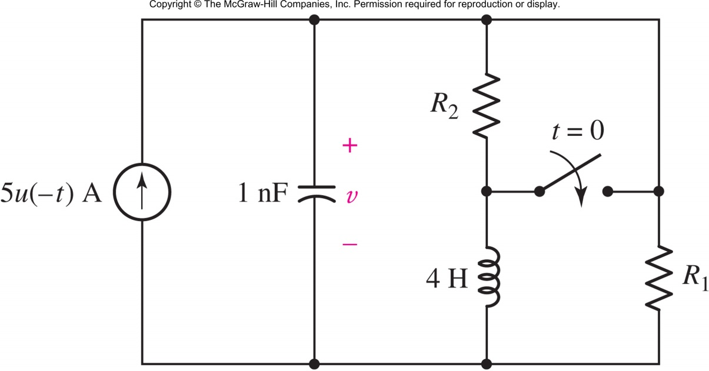
Example: Critical Damping
Find R₁ such that the circuit is critically damped for t>0 and R₂ so that v(0)=2 V.
Answer: R₁ = 31.63 kΩ, R₂=0.4Ω

Slide 19
Underdamped Response (α<ω₀)
If α<ω_{0,} define
and we have:
The solution is
or equivalently

Slide 20
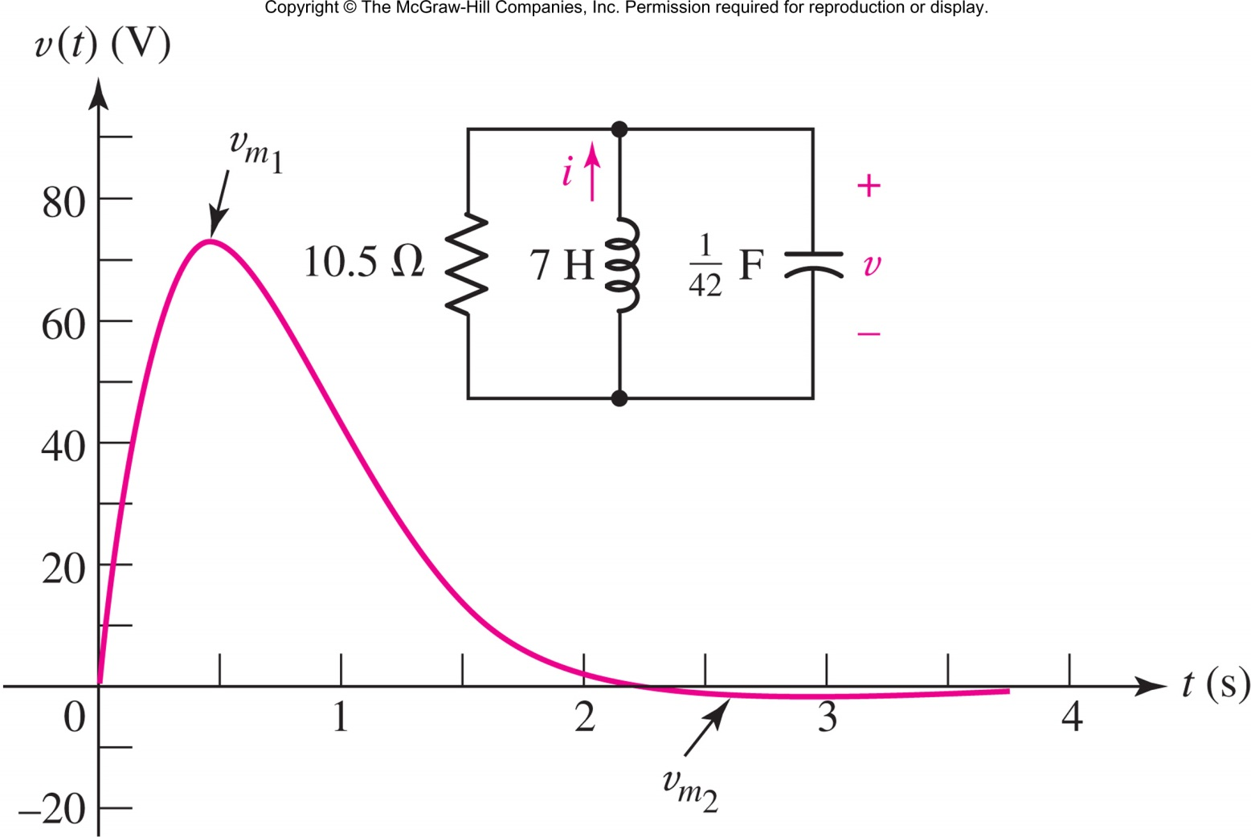

Example: Underdamped Response

Slide 21
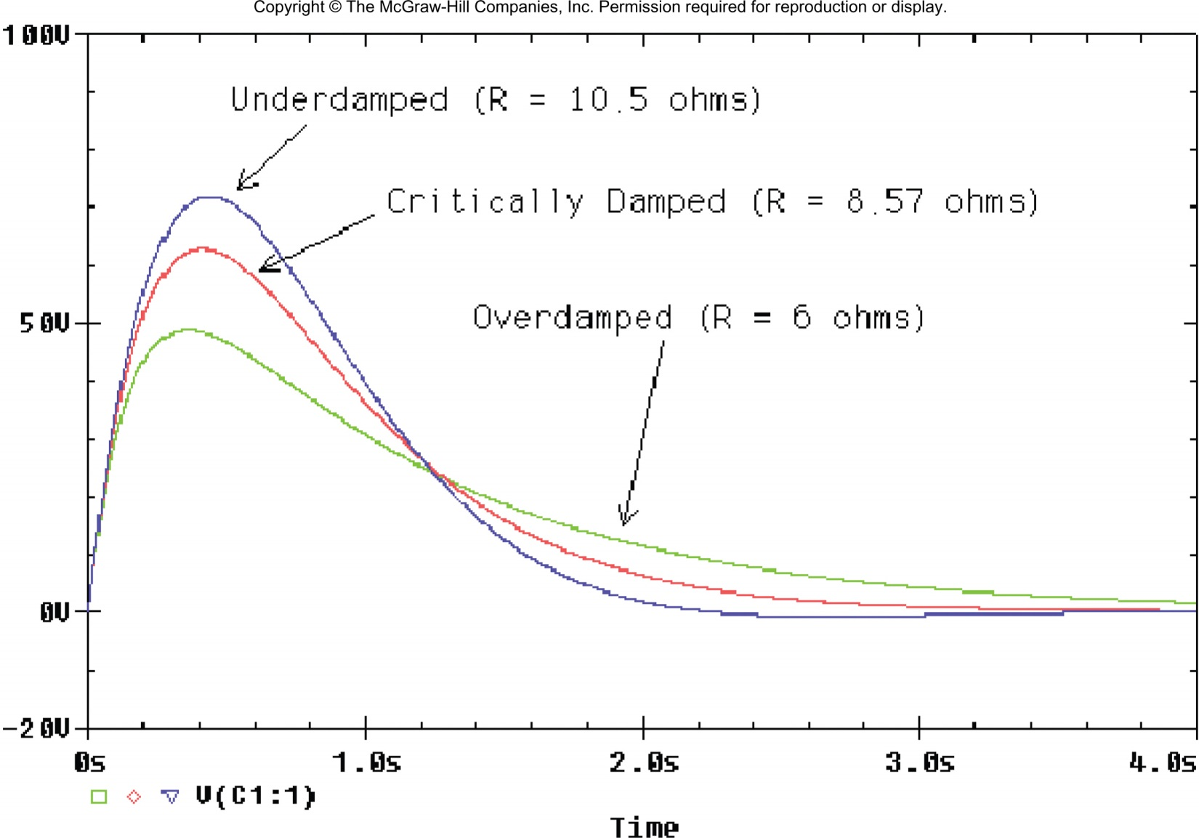
Comparing the Responses

Slide 22
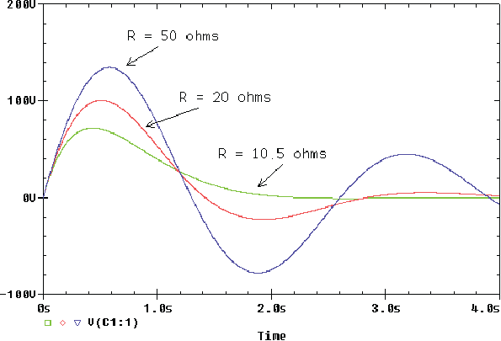
Comparing the Responses
Increasing decreases it damps slower

Slide 23
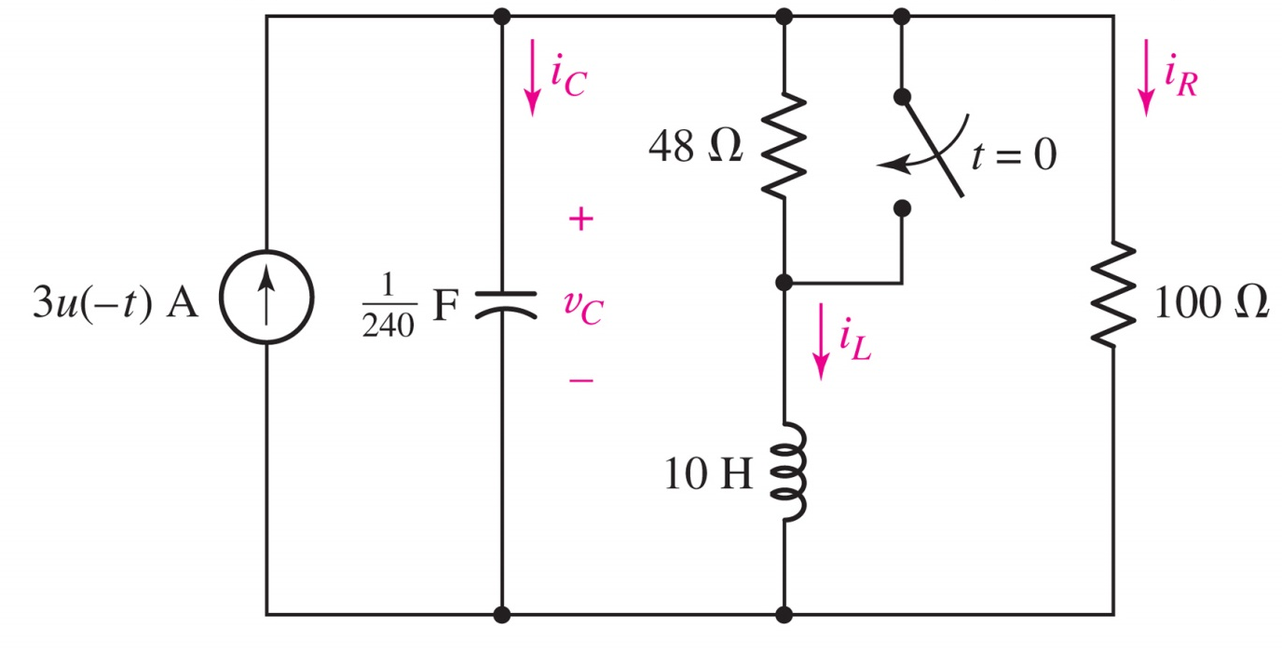
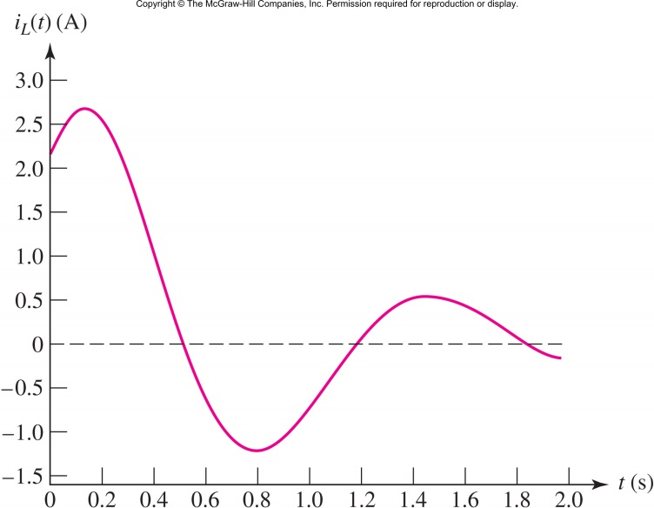
Example: Underdamped RLC Circuit
Show for t>0
i_{L} = e^{−1.2t} (2.027 cos 4.75t + 2.561 sin 4.75t)

Slide 24
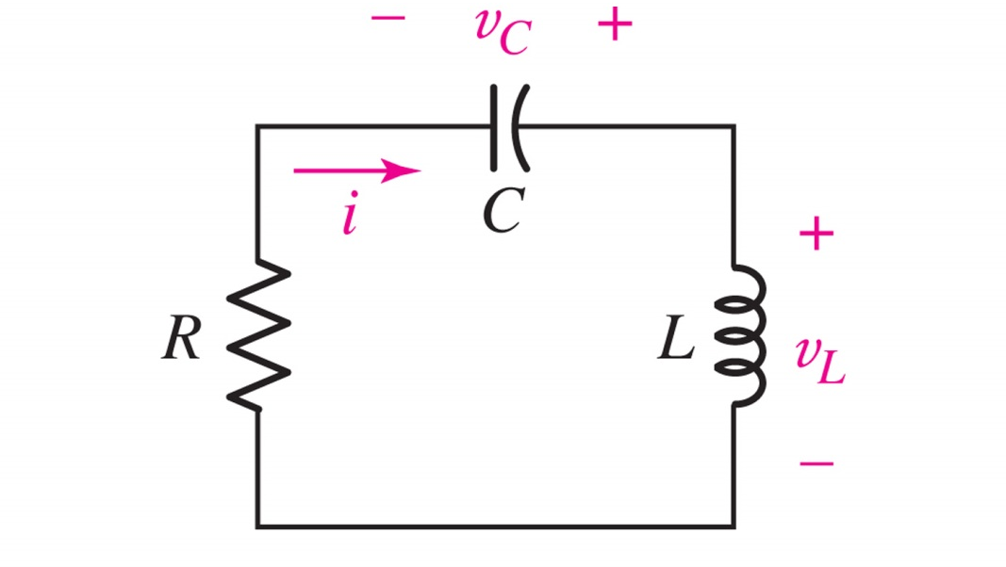
Source-Free Series RLC Circuit
For the series RLC circuit,
This circuit is the dual of the parallel RLC circuit.

Slide 25
Series RLC Differential Equation
The characteristic equation is
and the solution is
where
Answer: i₃(t) = 1.333 sin t V

Slide 26
Series RLC Circuit Solution
Define and
Then if
α>ω₀ (overdamped):
α=ω₀ (critically damped):
α<ω₀ (underdamped):

Slide 27
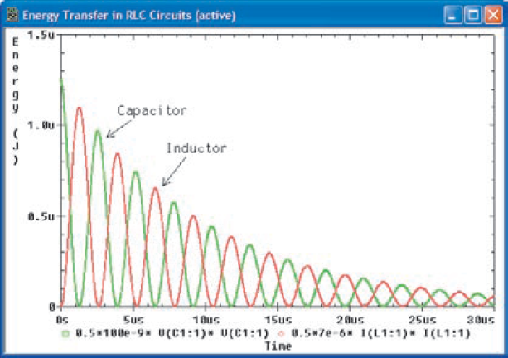

Energy Transfer in a Parallel RLC Circuit
Underdamped (R=100 Ω)
$$C=100nF, L=7μH$$

Slide 28
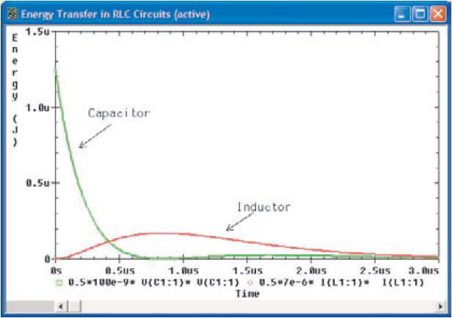
Energy Transfer in a Parallel RLC Circuit
Critically-damped (R=4.1833 Ω)
$$C=100nF, L=7μH$$

Slide 29
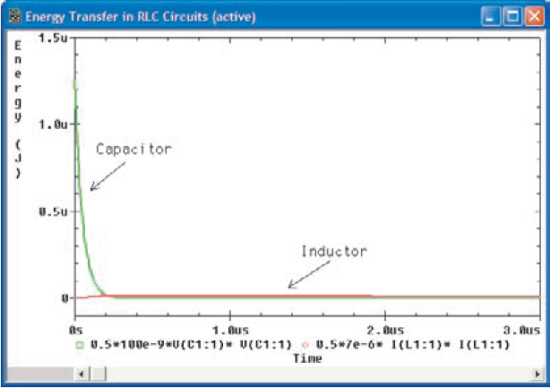
Energy Transfer in a Parallel RLC Circuit
Overdamped (R=1 Ω)
$$C=100nF, L=7μH$$

Slide 30
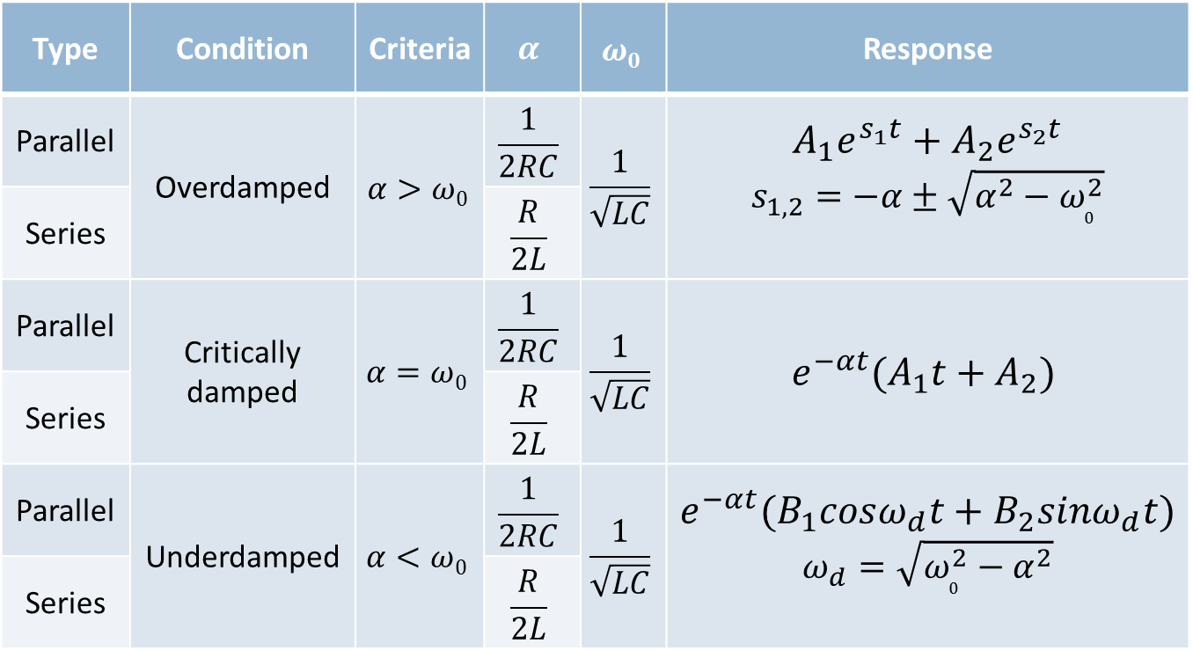
Summary of Source-free RLC Circuits
Type | Condition | Criteria | $$α$$ | $$ω0$$ | Response
Parallel | Overdamped | $$α>ω0$$ | $$\frac{1}{2RC}$$ | $$\frac{1}{\sqrt{LC}}$$ | $$A_{1}e^{s_{1}t}+A_{2}e^{s_{2}t}$$ $$s_{1,2}=−α±\sqrt{α^{2}−ω_{0}^{2}}$$
Series |  |  | $$\frac{R}{2L}$$
Parallel | Critically damped | $$α=ω0$$ | $$\frac{1}{2RC}$$ | $$\frac{1}{\sqrt{LC}}$$ | $$e^{−αt}(A_{1}t+A_{2})$$
Series |  |  | $$\frac{R}{2L}$$
Parallel | Underdamped | $$α<ω0$$ | $$\frac{1}{2RC}$$ | $$\frac{1}{\sqrt{LC}}$$ | $$e^{−αt}(B_{1}cosω_{d}t+B_{2}sinω_{d}t)$$ $$ω_{d}=\sqrt{ω_{0}^{2}−α^{2}}$$
Series |  |  | $$\frac{R}{2L}$$

Slide 31


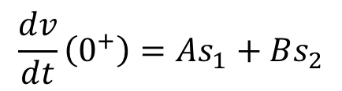


The Complete Response
The response of RLC circuits with dc sources:
complete response = natural response + forced response
The complete response must satisfy the initial conditions of both v(t) and dv(t)/dt
For example (for DC sources):
Natural response:
Complete response:
Initial conditions:
$$v\left(t\right)=vn\left(t\right)+vf\left(t\right)$$
$$vn\left(t\right)= Ae^{s_{1}t}+Be^{s_{2}t}$$
$$v\left(t\right)= V_{f}+Ae^{s_{1}t}+Be^{s_{2}t}$$
$$v\left(0^{+}\right)=V_{f}+A+B,$$
$$\frac{dv}{dt}\left(0^{+}\right)=As_{1}+Bs_{2}$$

Slide 32
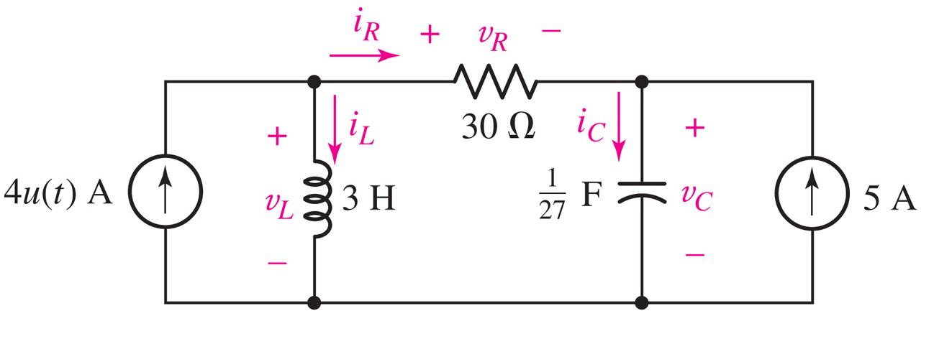
Example: Initial Conditions
Find the labeled voltages and currents at t=0⁻ and t=0⁺.
Answer:
i_{R}(0⁻) = −5 A v_{R}(0⁻) = −150 V i_{R}(0⁺) = −1 A v_{R}(0⁺) = −30 V
i_{L} (0⁻) = 5 A v_{L} (0⁻) = 0 V i_{L} (0⁺) = 5 A v_{L} (0⁺) = 120 V
i_{C}(0⁻) = 0 A v_{C}(0⁻) = 150 V i_{C}(0⁺) = 4 A v_{C}(0⁺) = 150 V

Slide 33
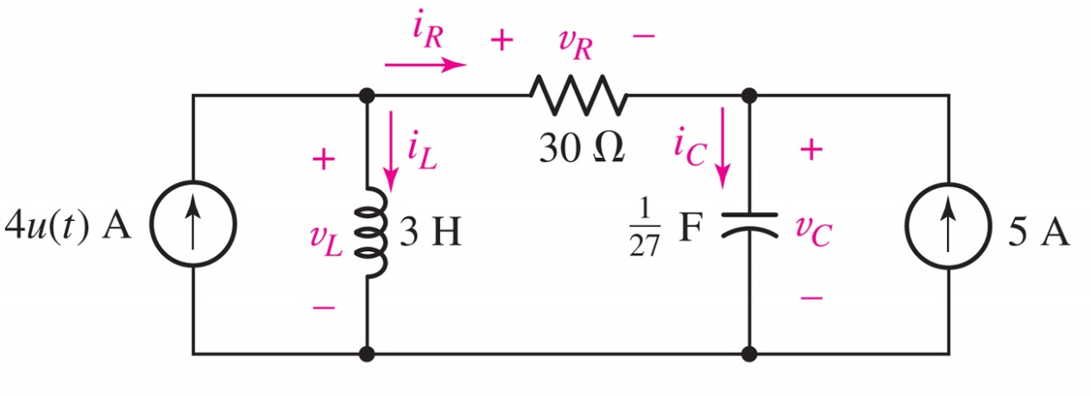
Example: Initial Slopes
Find the first derivatives of the labeled voltages and currents at t=0⁺.
Answer:
di_{R}/dt(0⁺) = −40 A/s dv_{R}/dt(0⁺) = -1200 V/s
di_{L} /dt(0⁺) = 40 A/s dv_{L} /dt(0⁺) = -1092 V/s
di_{C}/dt(0⁺) = -40 A/s dv_{C}/dt(0⁺) = 108 V/s

Slide 34
Example: Complete Response
Show that for t>0
v_{C}(t) = 150 + 13.5(e^{−t} − e^{−9t} ) volts

Slide 35
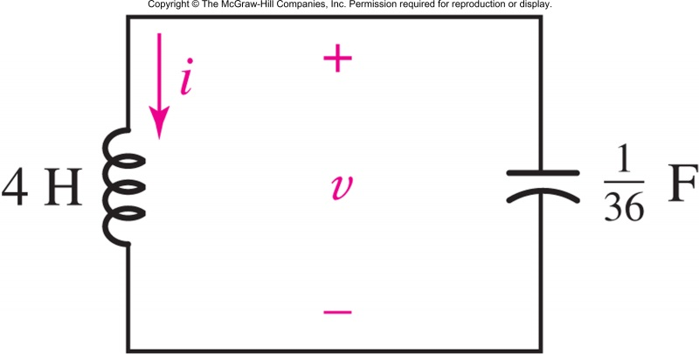
The Lossless LC Circuit
The resistor in the RLC circuit serves to dissipate initial stored energy.
When this resistor becomes 0 in the series RLC or infinite in the parallel RLC, the circuit will oscillate.
Example: for t>0,
v(t) =2 sin 3t
if i(0)=-1/6 A and v(0)=0 V

Slide 36
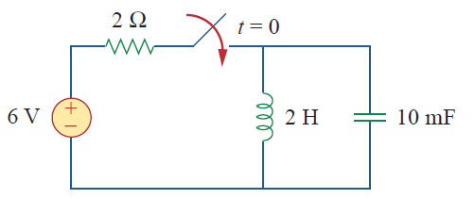
Duality
Two circuits are said to be duals of one another if they are described by the same characterizing equations with dual quantities interchanged.
Example: Find the dual of this circuit

Slide 37
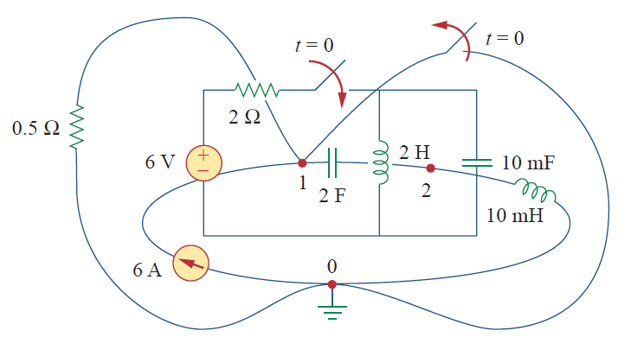
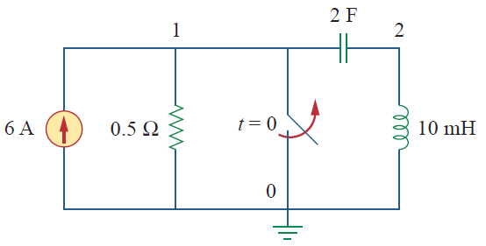
Duality
Solution

Slide 38
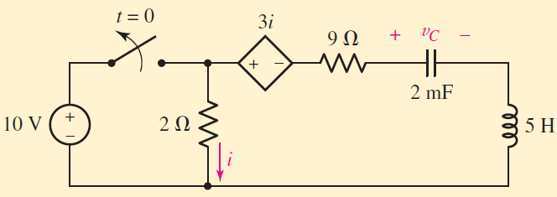
In-class Exercise
Show that:

Slide 39
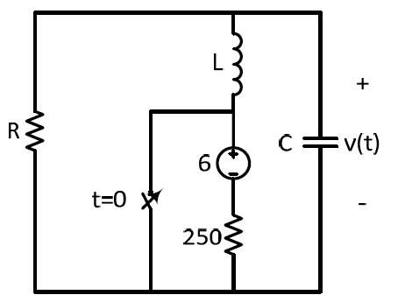

In-class Exercise 2
Switch is closed at t=0
Find R,L and C such that: $v\left(t\right)=5e^{−400t}sin⁡(300t)$

Slide 40
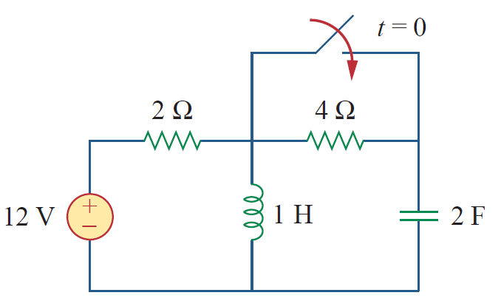
In-class Exercise 3
Find v_{c}(t) for t>0

